Slide 1
Recurrent Neural Networks

Slide 2
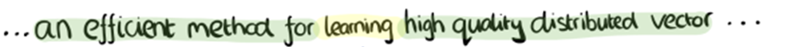
The limitation of neural networks presented so far
What happens when you have input sequences of varying length? Speech, text, etc.
i.e. data that unfolds over time
You want to exploit the temporal structure of the data
You want to make a decision about what has happened so far in the sequence
A major characteristic of all neural networks you’ve seen so far such as densely connected networks and convnets, is that they have no online memory.

Slide 3

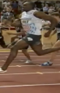


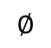
Examples of sequence data
Input Data
Output Data
Speech recognition
“The quick brown fox jumped over the lazy dog.”
Music generation
$$∅$$
Sentiment classification
“There is nothing to like in this movie.”
DNA sequence analysis
AGCCCCTGTGAGGAACTAG
AGCCCCTGTGAGGAACTAG
Machine translation
Voulez-vous chanter avec moi?
Do you want to sing with me?
Video activity recognition
Running
Name entity recognition
Yesterday, Harry Potter met Hermione Granger.
Yesterday, Harry Potter met Hermione Granger.

Slide 4
Recurrent neural network (RNN)
A recurrent neural network (RNN) processes sequences by iterating through the sequence elements and maintaining a state containing information relative to what it has seen so far.
In effect, an RNN is a type of neural network that has an internal loop
The state of the RNN is reset between processing two different, independent sequences (such as two different IMDB reviews), so you still consider one sequence a single data point: a single input to the network.
What changes is that this data point is no longer processed in a single step; rather, the network internally loops over sequence elements.

Slide 5
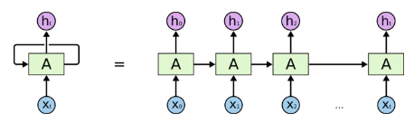
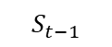
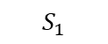
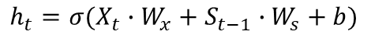
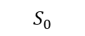
Recurrent neural networks (RNNs)
If you have a sequence of events, at each point in time you want to make a decision about what has happened so far in the sequence
You can use the same classifier at each point in time which simplifies things a lot
But since this is a sequence you also want to take into account the past
A natural thing to do is to use the state of the previous classifier as a summary of what has happened before
A part of a neural network that preserves some state across time steps is called a memory cell
This can be better understood if we unfold/unroll the graph of a RNN over time
output
output
$$h_{t}=σ(X_{t}∙W_{x}+S_{t−1}∙W_{s}+b)$$
State
$$S_{0}$$
$$S_{1}$$
$$S_{t−1}$$
State
input
input
Folded RNN
Unfolded RNN

Slide 6
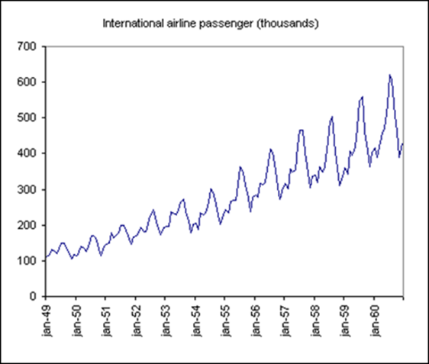
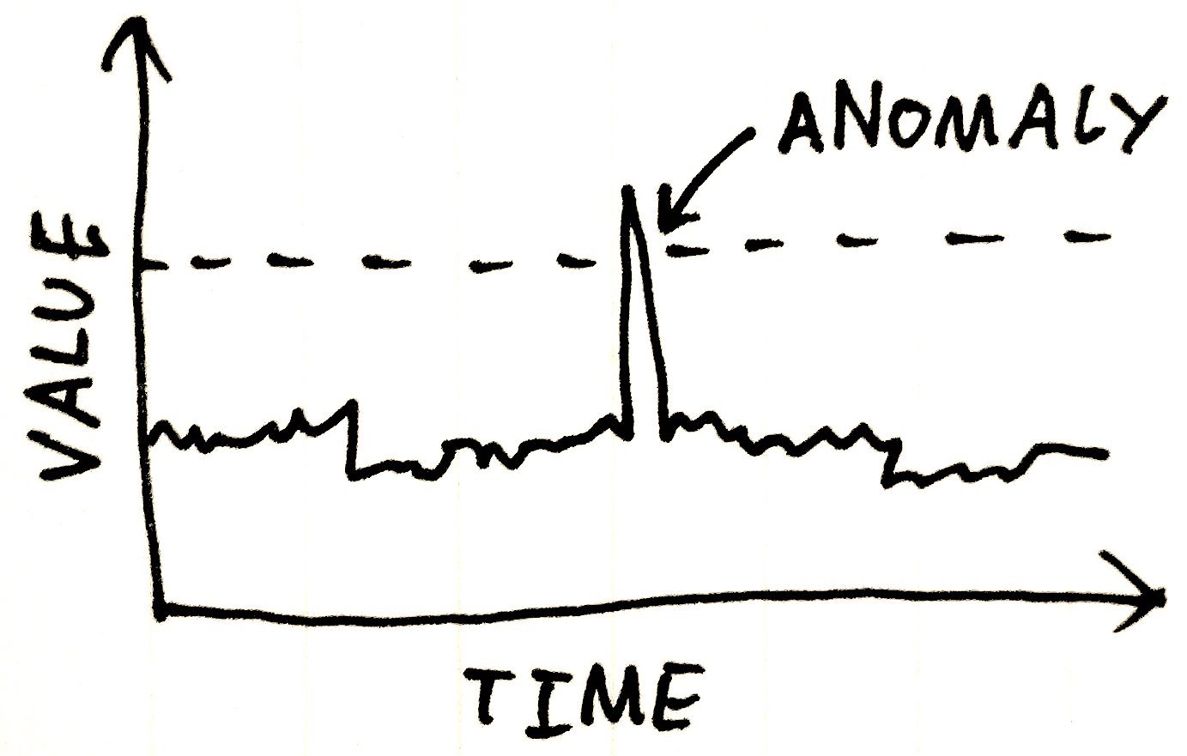
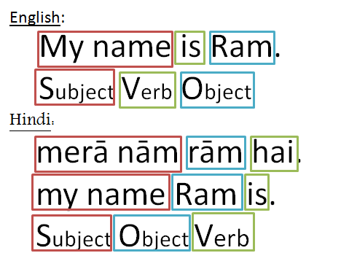
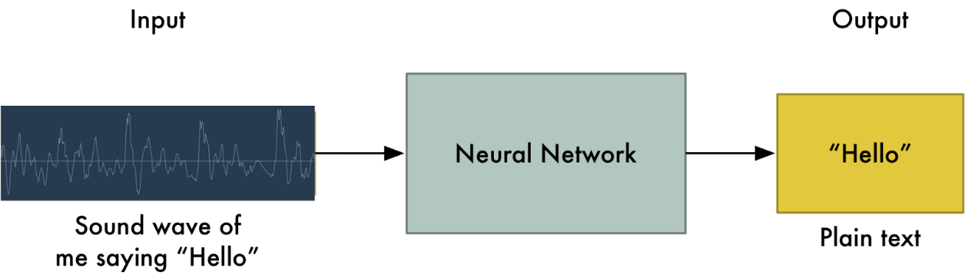
RNNs are useful for
Time series modeling (“predicting the future”)
Time series classification
Anomaly detection in time series
Sequence labeling (such as identifying entities in sequences)

Slide 7
RNN types classified by Input and output sequences
An RNN can simultaneously take a sequence of inputs and produce a sequence of outputs
For example, this type of network is useful for “predicting” time series such as stock prices: you feed it the prices over the last N days, and it must output the prices shifted by one day into the future (i.e., from N – 1 days ago to tomorrow).
Alternatively, you could feed the network a sequence of inputs, and ignore all outputs except for the last one, a sequence-to-vector network.
For example, you could feed the network a sequence of words corresponding to a movie review, and the network would output a sentiment score (e.g., from –1 [hate] to +1 [love]).
Conversely, you could feed the network a single input at the first time step (and zeros for all other time steps), and let it output a sequence (see the bottom-left network). This is a vector-to-sequence network.
For example, the input could be an image, and the output could be a caption for that image.
Lastly, you could have a sequence-to-vector network, called an encoder, followed by a vector-to-sequence network, called a decoder (see the bottom-right network). For example, this can be used for translating a sentence from one language to another.
You would feed the network a sentence in one language, the encoder would convert this sentence into a single vector representation, and then the decoder would decode this vector into a sentence in another language

Slide 8
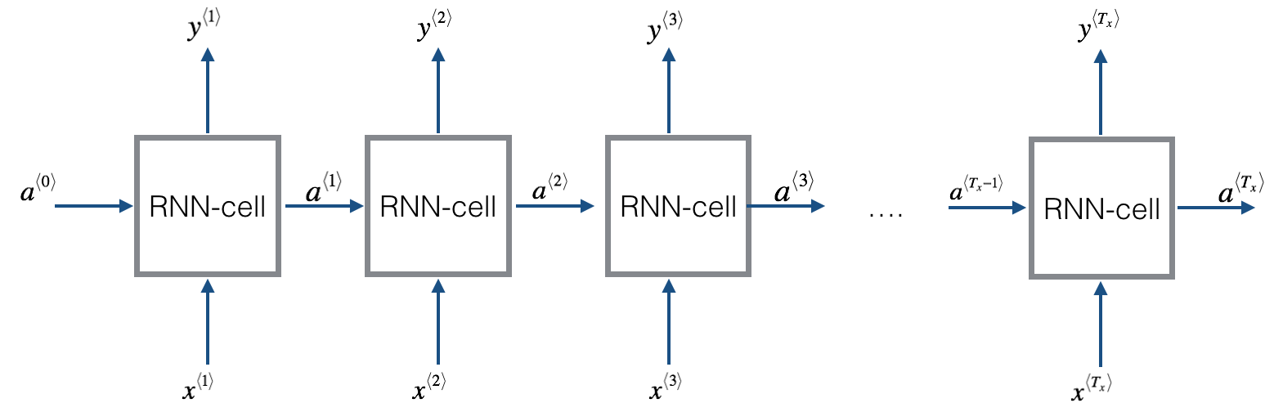
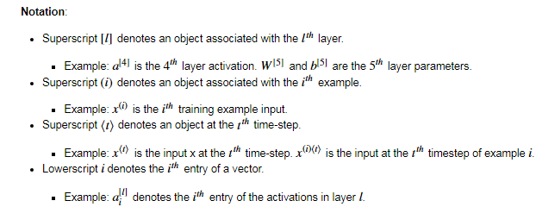
Forward propagation for a basic Recurrent Neural Network
A basic RNN has the structure shown below:

Slide 9
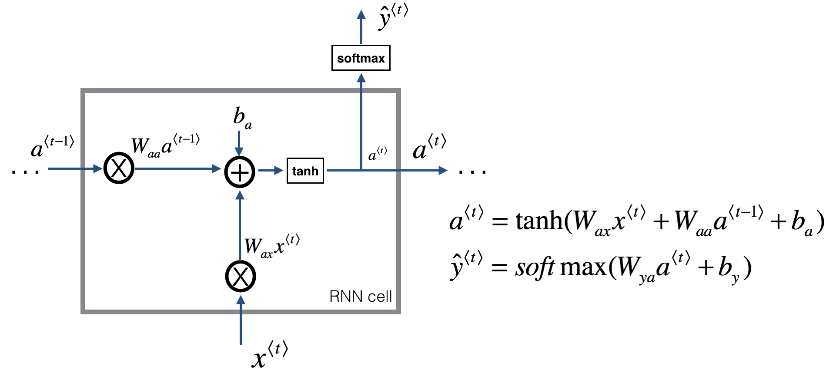
RNN cell
The following figure describes the operations for a single time-step of an RNN cell:
This will work well enough for some applications, but it suffers from vanishing gradient problems. So it works best when each output y^{⟨t⟩} can be estimated using mainly "local" context (meaning information from inputs x^{⟨t′⟩} where t′ is not too far from t).

Slide 10
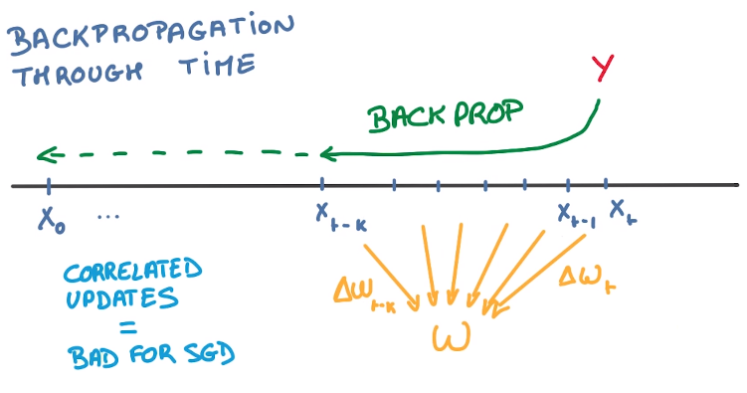
The big limitation of Recurrent neural networks (RNN)
RNNs are great… in theory
In practice, they often fail to deliver
This is because to compute the parameter updates of a recurrent network we need to back propagate derivatives through time
All these derivatives are going to be applied to the same parameters
That’s a lot of correlated updates which is bad for SGD since it is numerically unstable (underflow or overflow problems)

Slide 11
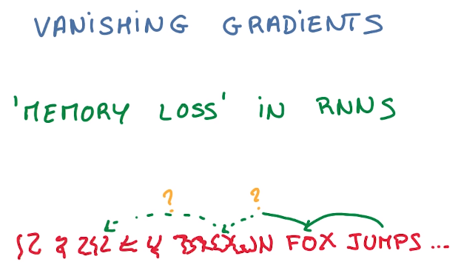
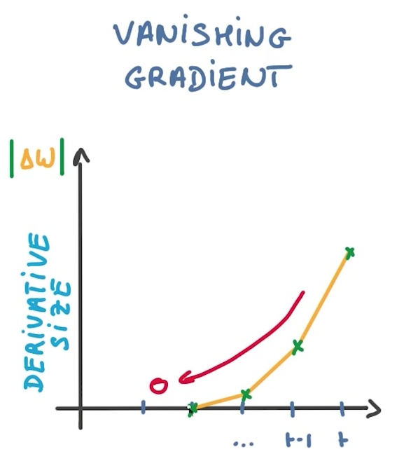
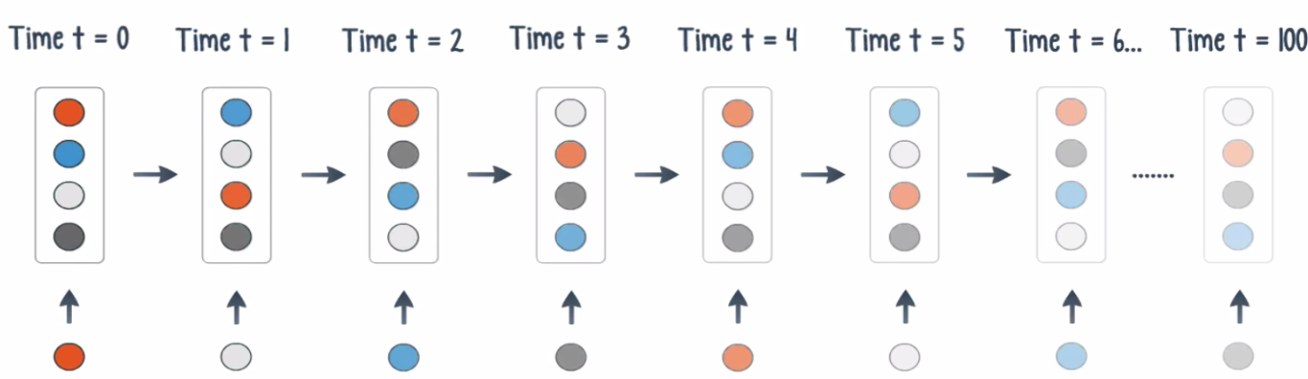
Vanishing gradients problem
Backpropagation, the master algorithm used to train deep neural networks, works by propagating a feedback signal from the output loss down to earlier layers.
If this feedback signal has to be propagated through a deep stack of layers, the signal may become tenuous or even be lost entirely, rendering the network untrainable.
This issue is known as vanishing gradients .
Vanishing gradients make your model only remember recent events and forget the more distant past
But in some sequences, what happened in the distant past is very relevant to understand the present time point

Slide 12
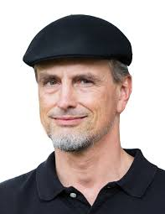
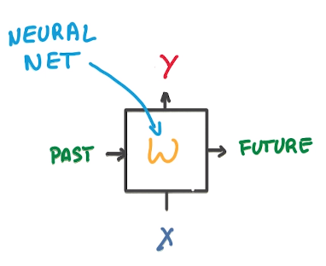
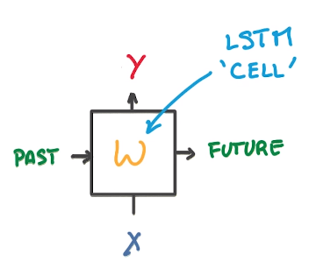
How to address vanishing gradients: LSTM (long short-term memory)
Jürgen Schmidhuber
An LSTM substitutes a traditional neural net with an LSTM cell
This greatly reduces the vanishing gradient problem

Slide 13
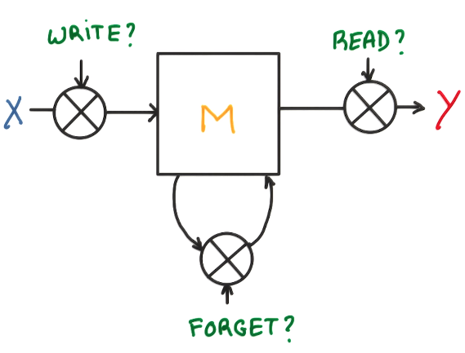




LSTM are a simple model of memory
Here is one way of writing that idea as a computational diagram of gates
Memory: matrix of values
Inputs coming into the memory
Gate
Outputs coming out of memory

Slide 14
LSTM
LSTMs add a way to carry information across many timesteps.
the LSTM similar to an RNN cell, except that its state is split in two vectors: f(t) and c(t) can think of f(t) as the short-term state and c(t) as the long-term state
The key idea is that the network can learn what to store in the long-term state, what to throw away, and what to read from it.
As the long-term state c(t–1) traverses the network from left to right, it first goes through a forget gate, dropping some memories, and then it adds some new memories via the addition operation (which adds the memories that were selected by an input gate)
Imagine a conveyor belt running parallel to the sequence you’re processing.
Information from the sequence can jump onto the conveyor belt at any point, be transported to a later timestep, and jump off, intact, when you need it.
This is essentially what LSTM does: it saves critical information for later, thus preventing older signals from gradually vanishing during processing.
Notes:
If you want to get philosophical, you can interpret what each of these operations is
meant to do. For instance, you can say that multiplying c_t and f_t is a way to deliberately
forget irrelevant information in the carry dataflow. Meanwhile, i_t and k_t provide
information about the present, updating the carry track with new information.
But at the end of the day, these interpretations don’t mean much, because what these
operations actually do is determined by the contents of the weights parameterizing
them; and the weights are learned in an end-to-end fashion, starting over with each
training round, making it impossible to credit this or that operation with a specific
purpose. The specification of an RNN cell (as just described) determines your hypothesis
space—the space in which you’ll search for a good model configuration during
training—but it doesn’t determine what the cell does; that is up to the cell weights.
The same cell with different weights can be doing very different things. So the combination
of operations making up an RNN cell is better interpreted as a set of constraints
on your search, not as a design in an engineering sense.

Slide 15
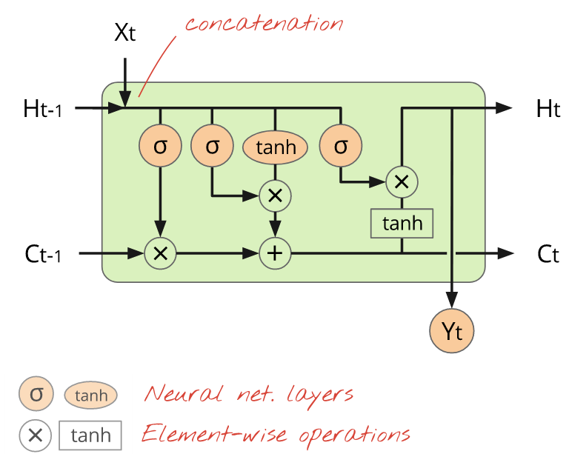
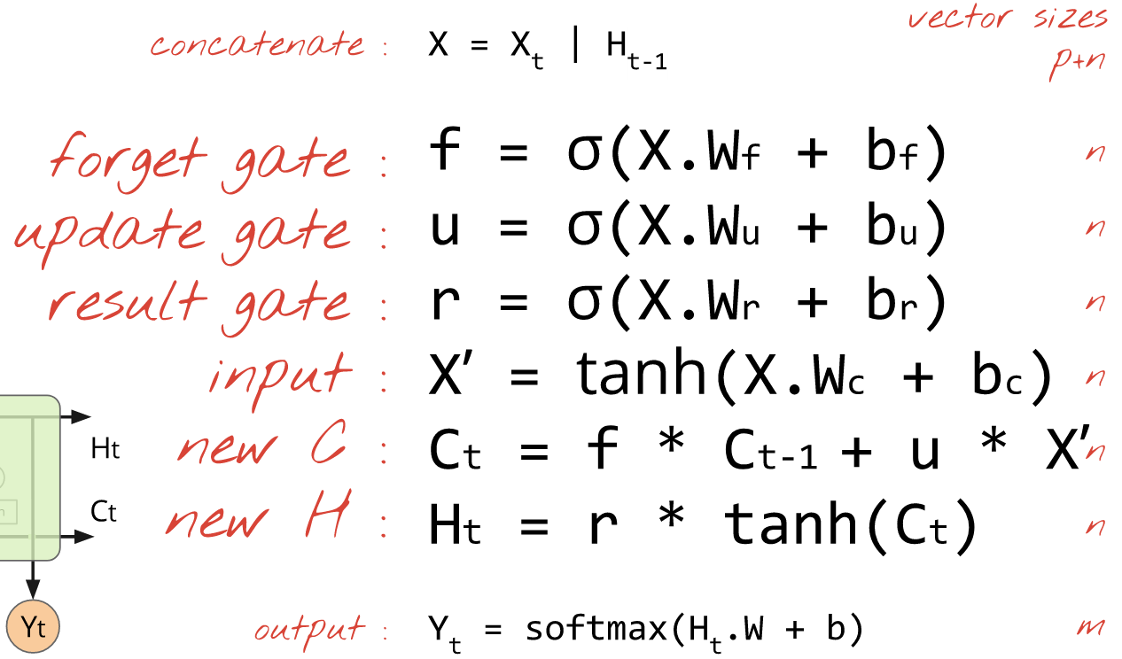
The LSTM cell will be better able to remember a piece of information and keep it saved for many timesteps.

Slide 16
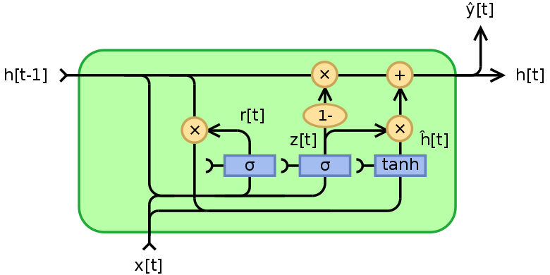
GRUs
Gated recurrent units (GRUs) are a gating mechanism in recurrent neural networks, introduced in 2014 by Kyunghyun Cho et al.
Their performance on some sequence data (speech signal modeling for instance) was found to be similar to that of long short-term memory (LSTM).
GRUs also exhibit better performance on smaller datasets.
They have fewer parameters than LSTM, as they lack an output gate and are cheaper to train
They are computationally cheaper to run in a model

Slide 17
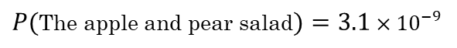
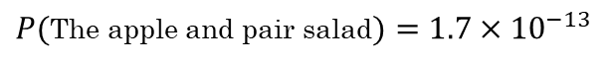
RNNs/LSTMs are very well suited for language modelling
But, What is language modelling?
Let’s look at a Speech recognition problem
The apple and pair salad.
The apple and pear salad.
A language model will be able to estimate the probability of a sequence of words coming from the modeled language:
$P($The apple and pair salad$)=1.7×{10}^{−13}$
$P($The apple and pear salad$)=3.1×{10}^{−9}$
Larger value denotes bigger probability

Slide 18
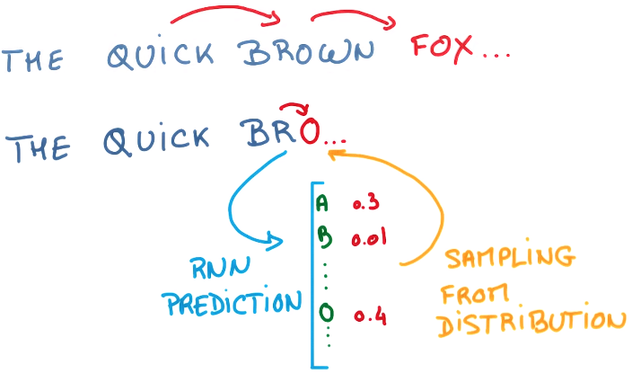
What can you do with an LSTM based RNN?
Predict the next step in a sequence
At a word or character level

Slide 19
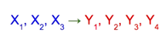
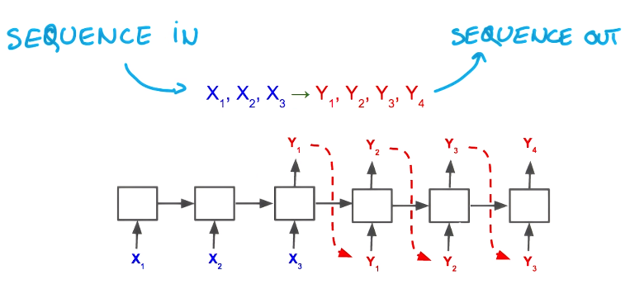
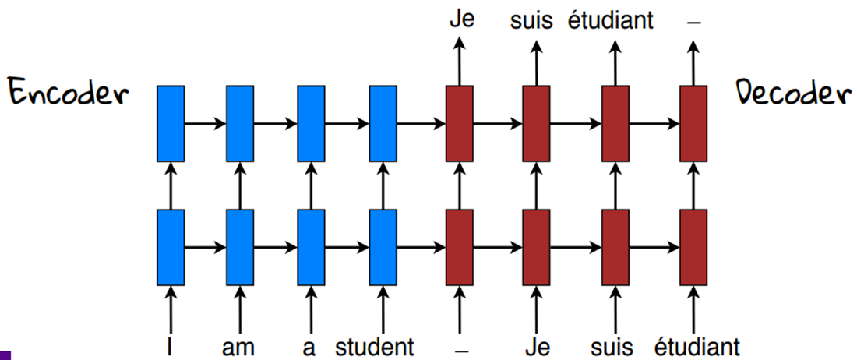
What can you do with an LSTM based RNN?
You can map sequences of arbitrary length to outputs of arbitrary length
Machine translation
encoder
decoder

Slide 20
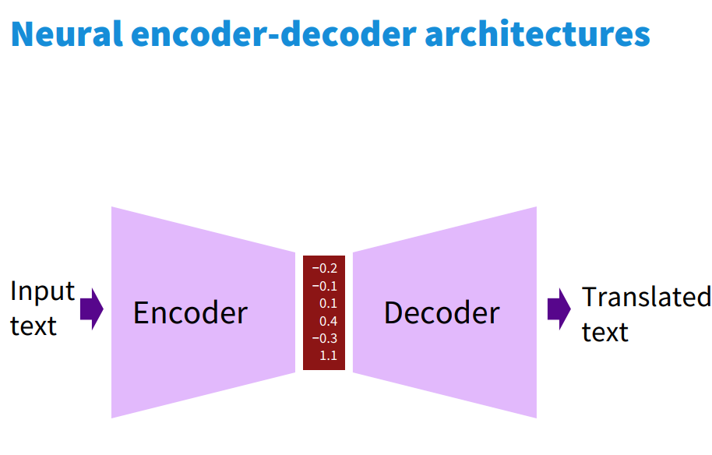
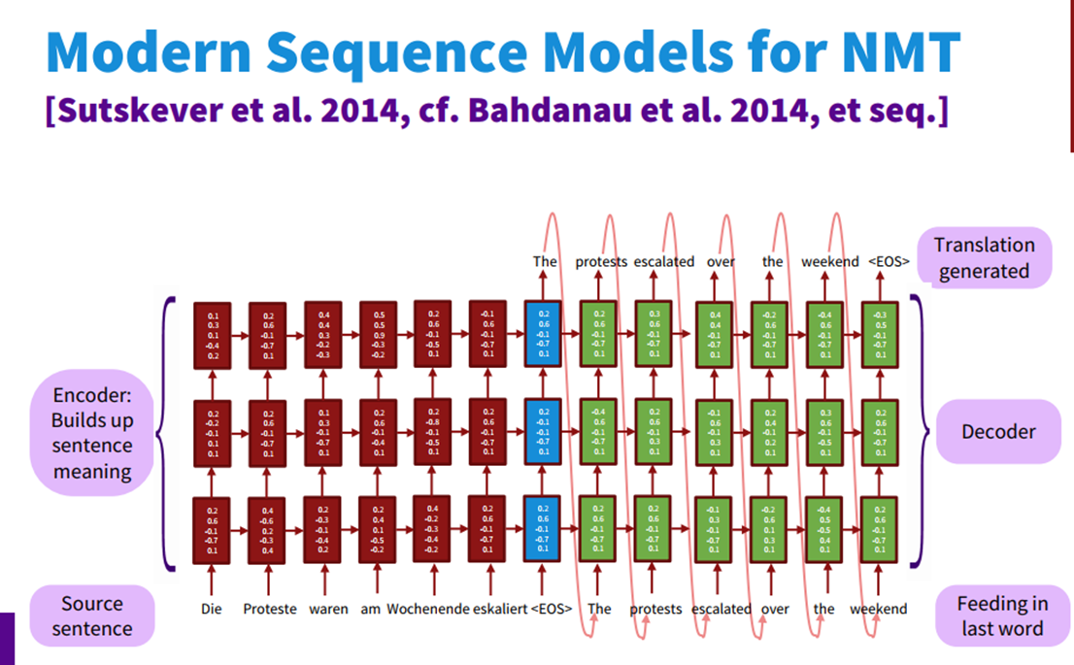
End to end training – neural encoder-decoder architectures

Slide 21
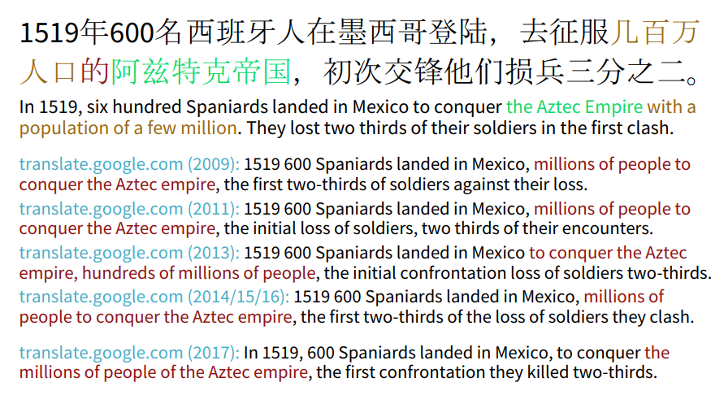
Progress in machine translation

Slide 22
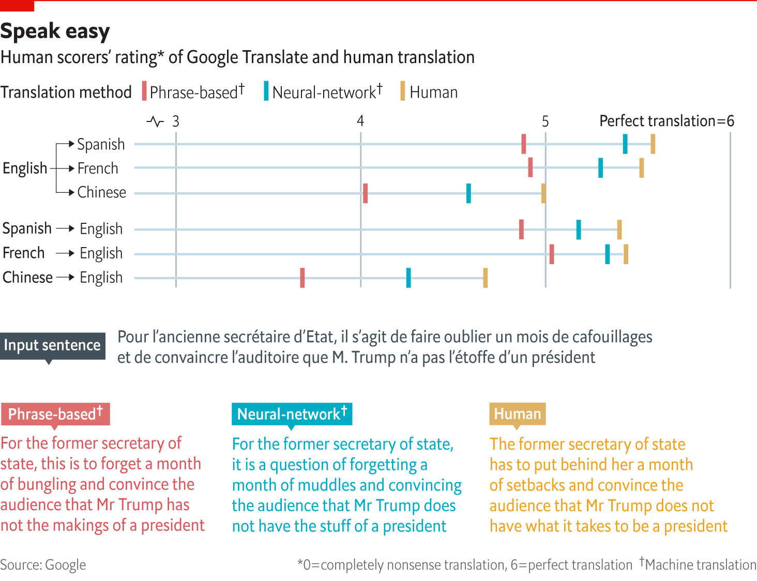

Slide 23
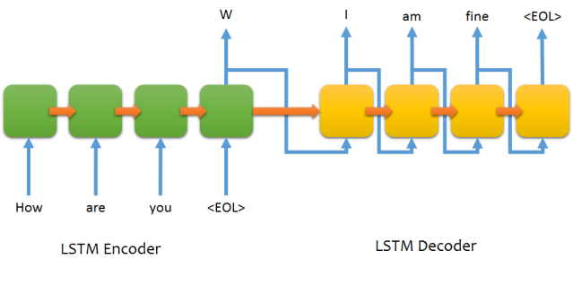
What can you do with an LSTM based RNN?
LSTMs as generative models
You can build and train sequence-to-sequence neural network using LSTMs
Such models are useful for machine translation, parsers, music generation…
And as chatbots (conversational agents)

Slide 24
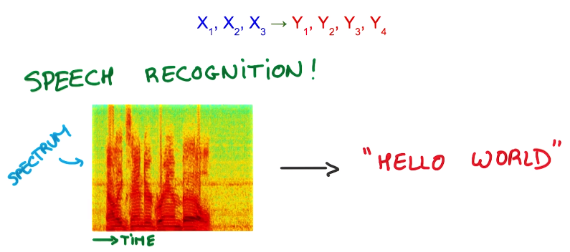
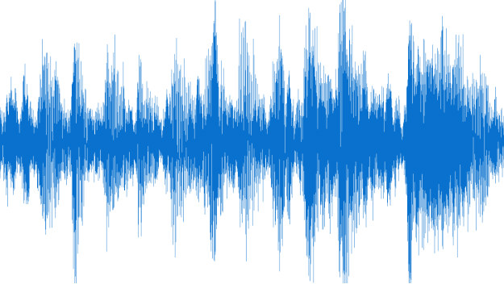
What can you do with an LSTM based RNN?
Speech recognition

Slide 25
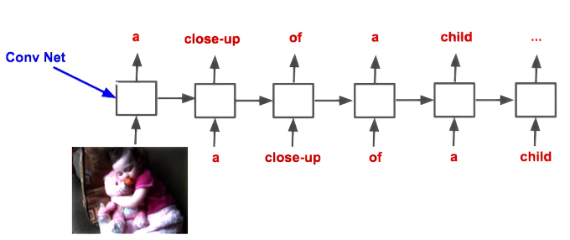
What can you do with an LSTM based RNN?
Image captioning by combining a convolutional network with an RNN

Slide 26
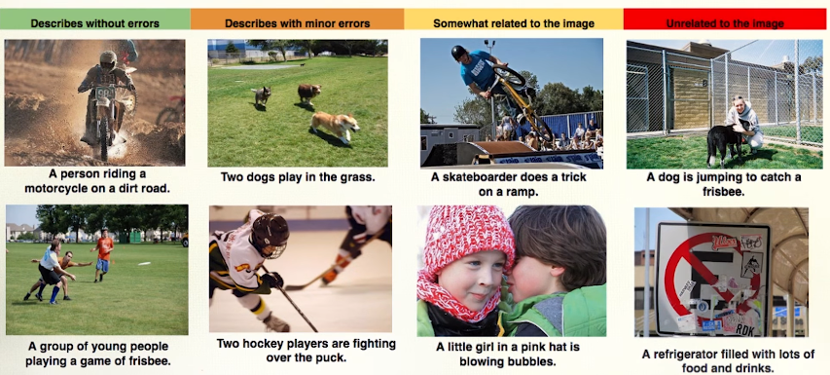
Image captioning
http://mscoco.org/

